Slide 1

BFS, DFS and Implementations
Lecture 23 (Graphs 2)
CS61B, Spring 2024 @ UC Berkeley
Slides credit: Josh Hug

Slide 2
Princeton Graphs API
The All Paths Problem
Princeton Graphs API
DepthFirstPaths Implementation
The Adjacency List
DepthFirstPaths Runtime
The All Shortest Paths Problem
BreadthFirstPaths
BreadthFirstPaths Implementation
Graph Implementations and Runtime
Project 2B Note
Lecture 23, CS61B, Spring 2024

Slide 3
Graph Representations
To Implement a graph algorithm like DepthFirstPaths, we need:
An API (Application Programming Interface) for graphs.
For our purposes today, these are our Graph methods, including their signatures and behaviors.
Defines how Graph client programmers must think.
A concrete data structure to represent our graphs.
Our choices can have profound implications on:
Runtime.
Memory usage.
Difficulty of implementing various graph algorithms.
Set
HashSet
TreeSet
Graph
API
Concrete
??
??

Slide 4
Graph API Decision #1: Integer Vertices
Common convention: Number nodes irrespective of “label”, and use number throughout the graph implementation. To lookup a vertex by label, you’d need to use a Map<Label, Integer>.
Dallas
1
Map<String, Integer>:
Austin: 0
Dallas: 1
Houston: 2
0
Austin
Houston
2
Intended graph.
How you’d build it.

Slide 5
Graph API
The Graph API from Princeton’s algorithms textbook.
public class Graph {
public Graph(int V): Create empty graph with v vertices
public void addEdge(int v, int w): add an edge v-w
Iterable<Integer> adj(int v): vertices adjacent to v
int V(): number of vertices
int E(): number of edges
...
Some features:
Number of vertices must be specified in advance.
Does not support weights (labels) on nodes or edges.
Has no method for getting the number of edges for a vertex (i.e. its degree).

Slide 6
Graph API
The Graph API from our optional textbook.
Example client:
public class Graph {
public Graph(int V): Create empty graph with v vertices
public void addEdge(int v, int w): add an edge v-w
Iterable<Integer> adj(int v): vertices adjacent to v
int V(): number of vertices
int E(): number of edges
...
/** degree of vertex v in graph G */
public static int degree(Graph G, int v) {
int degree = 0;
for (int w : G.adj(v)) {
degree += 1;
}
return degree; }
0
(degree = # edges)
3
1
2
degree(G, 1) = 2

Slide 7
Graph API
The Graph API from our optional textbook.
Challenge: Try to write a client method called print that prints out a graph.
public class Graph {
public Graph(int V): Create empty graph with v vertices
public void addEdge(int v, int w): add an edge v-w
Iterable<Integer> adj(int v): vertices adjacent to v
int V(): number of vertices
int E(): number of edges
...
0
$ java printDemo
0 - 1
0 - 3
1 - 0
1 - 2
2 - 1
3 - 0
3
1
public static void print(Graph G) {
???
}
2

Slide 8
Graph API
The Graph API from our optional textbook.
Print client:
public class Graph {
public Graph(int V): Create empty graph with v vertices
public void addEdge(int v, int w): add an edge v-w
Iterable<Integer> adj(int v): vertices adjacent to v
int V(): number of vertices
int E(): number of edges
...
public static void print(Graph G) {
for (int v = 0; v < G.V(); v += 1) {
for (int w : G.adj(v)) {
System.out.println(v + “-” + w);
}
}
}
0
$ java printDemo
0 - 1
0 - 3
1 - 0
1 - 2
2 - 1
3 - 0
3
1
2

Slide 9
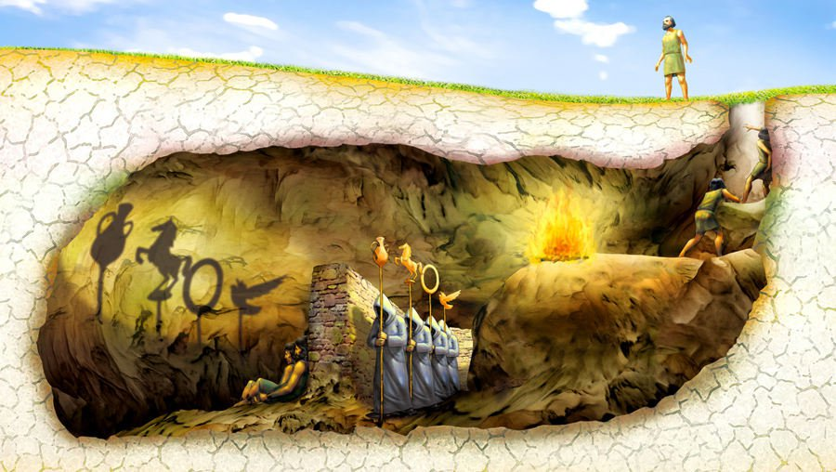
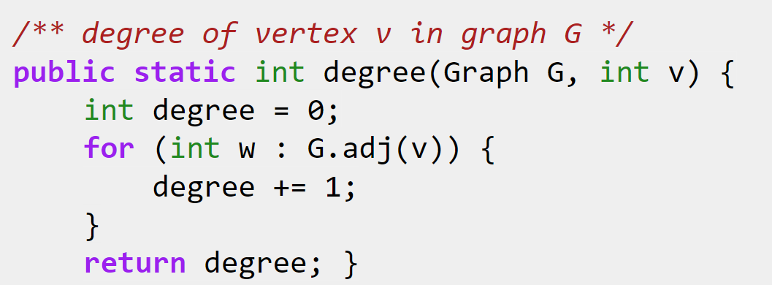
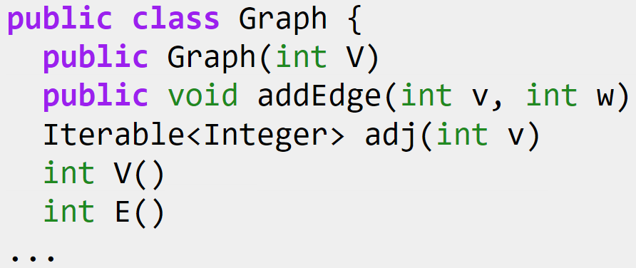
Graph API and DepthFirstPaths
Our choice of Graph API has deep implications on the implementation of DepthFirstPaths, BreadthFirstPaths, print, and other graph “clients”.
Our choice of concrete implementation will affect runtimes and memory usage.

Slide 10
DepthFirstPaths Implementation
The All Paths Problem
Princeton Graphs API
DepthFirstPaths Implementation
The Adjacency List
DepthFirstPaths Runtime
The All Shortest Paths Problem
BreadthFirstPaths
BreadthFirstPaths Implementation
Graph Implementations and Runtime
Project 2B Note
Lecture 23, CS61B, Spring 2024

Slide 11

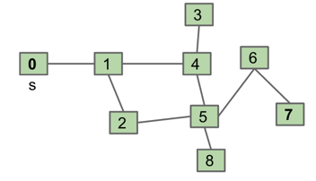
Depth First Search Implementation
Common design pattern in graph algorithms: Decouple type from processing algorithm.
Create a graph object.
Pass the graph to a graph-processing method (or constructor) in a client class.
Query the client class for information.
public class Paths {
public Paths(Graph G, int s): Find all paths from G
boolean hasPathTo(int v): is there a path from s to v?
Iterable<Integer> pathTo(int v): path from s to v (if any)
}
Paths.java

Slide 12
Example Usage
Start by calling: Paths P = new Paths(G, 0);
P.hasPathTo(3); //returns true
P.pathTo(3); //returns {0, 1, 4, 3}
Paths.java
public class Paths {
public Paths(Graph G, int s): Find all paths from G
boolean hasPathTo(int v): is there a path from s to v?
Iterable<Integer> pathTo(int v): path from s to v (if any)
}

Slide 13
DepthFirstPaths
Let’s review DepthFirstPaths by running the demo from last lecture again.
Will then discuss:
Implementation.
Runtime.

Slide 14
DepthFirstPaths, Recursive Implementation
public class DepthFirstPaths {
private boolean[] marked;
private int[] edgeTo;
private int s;
public DepthFirstPaths(Graph G, int s) {
...
dfs(G, s);
}
private void dfs(Graph G, int v) {
marked[v] = true;
for (int w : G.adj(v)) {
if (!marked[w]) {
edgeTo[w] = v;
dfs(G, w);
}
}
}
...
}
marked[v] is true iff v connected to s
edgeTo[v] is previous vertex on path from s to v
not shown: data structure initialization
find vertices connected to s.
recursive routine does the work and stores results in an easy to query manner!
Question to ponder: How would we write pathTo(v) and hasPathTo(v)?
Answer on next slide.

Slide 15
DepthFirstPaths, Recursive Implementation
public class DepthFirstPaths {
private boolean[] marked;
private int[] edgeTo;
private int s;
...
public Iterable<Integer> pathTo(int v) {
if (!hasPathTo(v)) return null;
List<Integer> path = new ArrayList<>();
for (int x = v; x != s; x = edgeTo[x]) {
path.add(x);
}
path.add(s);
Collections.reverse(path);
return path;
}
public boolean hasPathTo(int v) {
return marked[v];
}
}
marked[v] is true iff v connected to s
edgeTo[v] is previous vertex on path from s to v
To analyze the runtime, we need to create a concrete Graph Implementation.

Slide 16
The Adjacency List
The All Paths Problem
Princeton Graphs API
DepthFirstPaths Implementation
The Adjacency List
DepthFirstPaths Runtime
The All Shortest Paths Problem
BreadthFirstPaths
BreadthFirstPaths Implementation
Graph Implementations and Runtime
Project 2B Note
Lecture 23, CS61B, Spring 2024

Slide 17
Graph Representations
To Implement our graph algorithms like BreadthFirstPaths and DepthFirstPaths, we need:
An API (Application Programming Interface) for graphs.
For our purposes today, these are our Graph methods, including their signatures and behaviors.
Defines how Graph client programmers must think.
An underlying data structure to represent our graphs.
Our choices can have profound implications on:
Runtime.
Memory usage.
Difficulty of implementing various graph algorithms.
Graph
API
Concrete
??
??

Slide 18
Graph Representations
Just as we saw with trees, there are many possible implementations we could choose for our graphs.
Let’s review briefly some representations we saw for trees.

Slide 19
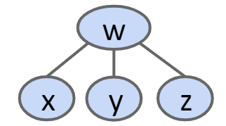
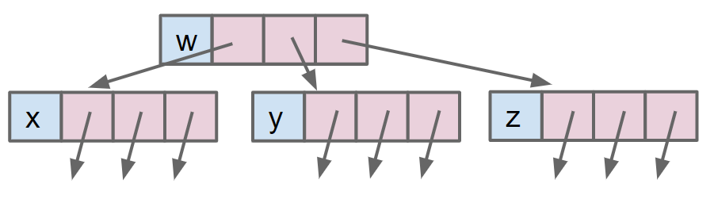
Tree Representations
We’ve seen many ways to represent the same tree. Example: 1a.
w
w
x
y
z
x
y
z
1a: Fixed Number of Links (One Per Child)

Slide 20
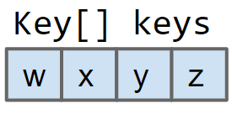
Tree Representations
We’ve seen many ways to represent the same tree. Example: 3.
Key[] keys
w
w
x
y
z
x
y
z
3: Array of Keys
Uses much less memory and operations will tend to be faster.
… but only works for complete trees.

Slide 21
Graph Representations
Graph Representation 1: Adjacency Matrix.
t
1
 | 0 | 1 | 2
0 | 0 | 1 | 1
1 | 0 | 0 | 1
2 | 0 | 0 | 0
s
0
2
w
 | 0 | 1 | 2 | 3
0 | 0 | 1 | 0 | 0
1 | 1 | 0 | 1 | 0
2 | 0 | 1 | 0 | 1
3 | 0 | 0 | 1 | 0
v
For undirected graph: Each edge is represented twice in the matrix. Simplicity at the expense of space.
1
0
2
3

Slide 22
More Graph Representations
Representation 2: Edge Sets: Collection of all edges.
Example: HashSet<Edge>, where each Edge is a pair of ints.
1
{(0, 1), (0, 2), (1, 2)}
0
2

Slide 23
More Graph Representations
Representation 3: Adjacency lists.
Common approach: Maintain array of lists indexed by vertex number.
Most popular approach for representing graphs.
Efficient when graphs are “sparse” (not too many edges).
1
0
2
0
1
2
[1, 2]
[2]

Slide 24
Graph Representations
To Implement our graph algorithms like BreadthFirstPaths and DepthFirstPaths, we need:
An API (Application Programming Interface) for graphs.
For our purposes today, these are our Graph methods, including their signatures and behaviors.
Defines how Graph client programmers must think.
An underlying data structure to represent our graphs.
Our choices can have profound implications on:
Runtime.
Memory usage.
Difficulty of implementing various graph algorithms.
Graph
API
Concrete
Adjacency List
??

Slide 25
Graph Printing Runtime: http://yellkey.com/second
What is the order of growth of the running time of the print client if the graph uses an adjacency-list representation, where V is the number of vertices, and E is the total number of edges?
Θ(V)
Θ(V + E)
Θ(V²)
Θ(V*E)
Runtime to iterate over v’s neighbors?
How many vertices do we consider?
for (int v = 0; v < G.V(); v += 1) {
for (int w : G.adj(v)) {
System.out.println(v + “-” + w);
}
}
b
0
1
2
[1, 2]
[2]
a
c
Notes:
https://docs.google.com/forms/d/e/1FAIpQLSfQFHtzvfBJqNHluwqdQR-JnlTcgZ3e13w5m-CKFAuCAi6MXQ/viewform

Slide 26
Graph Printing Runtime: http://yellkey.com/second
What is the order of growth of the running time of the print client if the graph uses an adjacency-list representation, where V is the number of vertices, and E is the total number of edges?
Θ(V)
Θ(V + E)
Θ(V²)
Θ(V*E)
Runtime to iterate over v’s neighbors? List can be between 1 and V items.
Ω(1), O(V).
How many vertices do we consider?
V.
for (int v = 0; v < G.V(); v += 1) {
for (int w : G.adj(v)) {
System.out.println(v + “-” + w);
}
}
Best case: Θ(V) Worst case: Θ(V²)
b
0
1
2
[1, 2]
[2]
a
c

Slide 27
Graph Printing Runtime: http://yellkey.com/support
What is the order of growth of the running time of the print client if the graph uses an adjacency-list representation, where V is the number of vertices, and E is the total number of edges?
Θ(V)
Θ(V + E)
Θ(V²)
Θ(V*E)
Runtime to iterate over v’s neighbors? List can be between 1 and V items.
Ω(1), O(V).
How many vertices do we consider?
V.
for (int v = 0; v < G.V(); v += 1) {
for (int w : G.adj(v)) {
System.out.println(v + “-” + w);
}
}
?
?
Best case: Θ(V) Worst case: Θ(V²)
?
?
?
b
0
1
2
[1, 2]
[2]
a
c
Notes:
https://docs.google.com/forms/d/e/1FAIpQLSdQ8xjXSrDFdXGwcksdBKOchzqfEKsT50AH0Q6UN9jvcJneYA/viewform

Slide 28
Graph Printing Runtime: http://yellkey.com/support
What is the order of growth of the running time of the print client if the graph uses an adjacency-list representation, where V is the number of vertices, and E is the total number of edges?
Θ(V)
Θ(V + E)
Θ(V²)
Θ(V*E)
Best case: Θ(V) Worst case: Θ(V²)
All cases: Θ(V + E)
v+=1 happens V times.
Print happens 2E times.
for (int v = 0; v < G.V(); v += 1) {
for (int w : G.adj(v)) {
System.out.println(v + “-” + w);
}
}
Cost model in this analysis is the sum of:
v +=1 operations
println calls
0
1
2
[1, 2]
[2]

Slide 29
Θ(V + E) Interpretation
Runtime: Θ(V + E)
How to interpret: No matter what “family” of increasingly complex graphs we generate, as V and E grow, the runtime will always grow exactly as Θ(V + E).
Example shape 1: Very sparse graph where E grows very slowly, e.g. every vertex is connected to its square: 2 - 4, 3 - 9, 4 - 16, 5 - 25, etc.
E is Θ(sqrt(V)). Runtime is Θ(V + sqrt(V)), which is just Θ(V).
Example shape 2: Very dense graph where E grows very quickly, e.g. every vertex connected to every other.
E is Θ(V²). Runtime is Θ(V + V²), which is just Θ(V²).
for (int v = 0; v < G.V(); v += 1) {
for (int w : G.adj(v)) {
System.out.println(v + “-” + w);
}
}
V is total number of vertices.
E is total number of edges in the entire graph.

Slide 30
More Θ(V + E) Interpretation
Runtime: Θ(V + E)
Θ(V + E) is the equivalent of Θ(max(V, E)).
Both are technically correct, but the sum is used more often.
Note: We never formally defined asymptotics on multiple variables, and it turns out to be somewhat poorly defined.
See: https://people.cs.ksu.edu/~rhowell/asymptotic.pdf
for (int v = 0; v < G.V(); v += 1) {
for (int w : G.adj(v)) {
System.out.println(v + “-” + w);
}
}
V is total number of vertices.
E is total number of edges in the entire graph.

Slide 31
DepthFirstPaths Runtime
The All Paths Problem
Princeton Graphs API
DepthFirstPaths Implementation
The Adjacency List
DepthFirstPaths Runtime
The All Shortest Paths Problem
BreadthFirstPaths
BreadthFirstPaths Implementation
Graph Implementations and Runtime
Project 2B Note
Lecture 23, CS61B, Spring 2024

Slide 32
DepthFirstPaths, Recursive Implementation
public class DepthFirstPaths {
private boolean[] marked;
private int[] edgeTo;
private int s;
public DepthFirstPaths(Graph G, int s) {
...
dfs(G, s);
}
private void dfs(Graph G, int v) {
marked[v] = true;
for (int w : G.adj(v)) {
if (!marked[w]) {
edgeTo[w] = v;
dfs(G, w);
}
}
}
...
}
marked[v] is true iff v connected to s
edgeTo[v] is previous vertex on path from s to v
not shown: data structure initialization
find vertices connected to s.
recursive routine does the work and stores results in an easy to query manner!
Question to ponder: How would we write pathTo(v) and hasPathTo(v)?
Answer on next slide.

Slide 33
DepthFirstPaths, Recursive Implementation
public class DepthFirstPaths {
private boolean[] marked;
private int[] edgeTo;
private int s;
...
public Iterable<Integer> pathTo(int v) {
if (!hasPathTo(v)) return null;
List<Integer> path = new ArrayList<>();
for (int x = v; x != s; x = edgeTo[x]) {
path.add(x);
}
path.add(s);
Collections.reverse(path);
return path;
}
public boolean hasPathTo(int v) {
return marked[v];
}
}
marked[v] is true iff v connected to s
edgeTo[v] is previous vertex on path from s to v

Slide 34
Runtime for DepthFirstPaths
Give a O bound for the runtime for the DepthFirstPaths constructor.
public class DepthFirstPaths {
private boolean[] marked;
private int[] edgeTo;
private int s;
public DepthFirstPaths(Graph G, int s) {
...
dfs(G, s);
}
private void dfs(Graph G, int v) {
marked[v] = true;
for (int w : G.adj(v)) {
if (!marked[w]) {
edgeTo[w] = v;
dfs(G, w);
}
}
} ...
}
Assume graph uses adjacency list!

Slide 35
Runtime for DepthFirstPaths
Give a O bound for the runtime for the DepthFirstPaths constructor.
public class DepthFirstPaths {
private boolean[] marked;
private int[] edgeTo;
private int s;
public DepthFirstPaths(Graph G, int s) {
...
dfs(G, s);
}
private void dfs(Graph G, int v) {
marked[v] = true;
for (int w : G.adj(v)) {
if (!marked[w]) {
edgeTo[w] = v;
dfs(G, w);
}
}
} ...
}
O(V + E)
Each vertex is visited at most once (O(V)).
Each edge is considered at most twice (O(E)).
vertex visits (no more than V calls)
edge considerations, each constant time
(no more than 2E calls)
Cost model in analysis above is the sum of:
Number of dfs calls.
marked[w] checks.
Assume graph uses adjacency list!

Slide 36
Runtime for DepthFirstPaths
Very hard question: Could we say the runtime is O(E)?
public class DepthFirstPaths {
private boolean[] marked;
private int[] edgeTo;
private int s;
public DepthFirstPaths(Graph G, int s) {
...
dfs(G, s);
}
private void dfs(Graph G, int v) {
marked[v] = true;
for (int w : G.adj(v)) {
if (!marked[w]) {
edgeTo[w] = v;
dfs(G, w);
}
}
} ...
}
Argument: Can only visit a vertex if there is an edge to it.
# of DFS calls is bounded above by E.
So why not just say O(E)?
Assume graph uses adjacency list!

Slide 37
Runtime for DepthFirstPaths
Very hard question: Could we say the runtime is O(E)? No.
public class DepthFirstPaths {
private boolean[] marked;
private int[] edgeTo;
private int s;
public DepthFirstPaths(Graph G, int s) {
...
dfs(G, s);
}
private void dfs(Graph G, int v) {
marked[v] = true;
for (int w : G.adj(v)) {
if (!marked[w]) {
edgeTo[w] = v;
dfs(G, w);
}
}
} ...
}
Can’t say O(E)!
Constructor has to create an all false marked array.
This marking of all vertices as false takes Θ(V) time.
Our cost model earlier (dfs calls + marked checks) does not provide a tight bound.
Assume graph uses adjacency list!

Slide 38
Graph Problems
Problem | Problem Description | Solution | Efficiency (adj. list)
s-t paths | Find a path from s to every reachable vertex. | DepthFirstPaths.java Demo | O(V+E) time Θ(V) space
Runtime is O(V+E)
Based on cost model: O(V) dfs calls and O(E) marked[w] checks.
Can’t say O(E) because creating marked array
Note, can’t say Θ(V+E), example: Graph with no edges touching source.
Space is Θ(V).
Need arrays of length V to store information.

Slide 39
BreadthFirstPaths
The All Paths Problem
Princeton Graphs API
DepthFirstPaths Implementation
The Adjacency List
DepthFirstPaths Runtime
The All Shortest Paths Problem
BreadthFirstPaths
BreadthFirstPaths Implementation
Graph Implementations and Runtime
Project 2B Note
Lecture 23, CS61B, Spring 2024

Slide 40
Tree and Graph Traversals
Just as there are many tree traversals:
Preorder: DBACFEG
Inorder: ABCDEFG
Postorder: ACBEGFD
Level order: DBFACEG
D
B
F
A
C
E
G
So too are there many graph traversals, given some source:
DFS Preorder: 012543678 (dfs calls).
DFS Postorder: 347685210 (dfs returns).
BFS order: Act in order of distance from s.
BFS stands for “breadth first search”.
Analogous to “level order”. Search is wide, not deep.
0 1 24 53 68 7
3
0
1
4
6
s
2
5
7
8

Slide 41
Shortest Paths Challenge (Video Viewers Only)
2
s
0
3
5
1
4
6
7
Goal: Given the graph above, find the shortest path from s to all other vertices.
Give a general algorithm.
Hint: You’ll need to somehow visit vertices in BFS order.
Hint #2: You’ll need to use some kind of data structure.
Hint #3: Don’t use recursion.

Slide 42
BFS Answer
Breadth First Search.
Initialize a queue with a starting vertex s and mark that vertex.
A queue is a list that has two operations: enqueue (a.k.a. addLast) and dequeue (a.k.a. removeFirst).
Let’s call this the queue our fringe.
Repeat until queue is empty:
Remove vertex v from the front of the queue.
For each unmarked neighbor n of v:
Mark n.
Set edgeTo[n] = v (and/or distTo[n] = distTo[v] + 1).
Add n to end of queue.
A queue is the opposite of a stack. Stack has push (addFirst) and pop (removeFirst).
Do this if you want to track distance value.

Slide 43
BreadthFirstPaths Demo
Goal: Find shortest path between s and every other vertex.
Initialize the fringe (a queue with a starting vertex s) and mark that vertex.
Repeat until fringe is empty:
Remove vertex v from fringe.
For each unmarked neighbor n of v: mark n, add n to fringe, set edgeTo[n] = v, set distTo[n] = distTo[v] + 1.
3
# marked edgeTo distTo
0 F - 0
1 F - -
2 F - -
3 F - -
4 F - -
5 F - -
6 F - -
7 F - -
8 F - -
0
1
4
6
s
2
5
7
8
Queue: []

Slide 44
BreadthFirstPaths Demo
Goal: Find shortest path between s and every other vertex.
Initialize the fringe (a queue with a starting vertex s) and mark that vertex.
Repeat until fringe is empty:
Remove vertex v from fringe.
For each unmarked neighbor n of v: mark n, add n to fringe, set edgeTo[n] = v, set distTo[n] = distTo[v] + 1.
3
# marked edgeTo distTo
0 T - 0
1 F - -
2 F - -
3 F - -
4 F - -
5 F - -
6 F - -
7 F - -
8 F - -
0
1
4
6
s
2
5
7
8
Queue: [0]

Slide 45
BreadthFirstPaths Demo
Goal: Find shortest path between s and every other vertex.
Initialize the fringe (a queue with a starting vertex s) and mark that vertex.
Repeat until fringe is empty:
Remove vertex v from fringe.
For each unmarked neighbor n of v: mark n, add n to fringe, set edgeTo[n] = v, set distTo[n] = distTo[v] + 1.
3
# marked edgeTo distTo
0 T - 0
1 F - -
2 F - -
3 F - -
4 F - -
5 F - -
6 F - -
7 F - -
8 F - -
v
0
1
4
6
s
2
5
7
8
Queue: []

Slide 46
BreadthFirstPaths Demo
Goal: Find shortest path between s and every other vertex.
Initialize the fringe (a queue with a starting vertex s) and mark that vertex.
Repeat until fringe is empty:
Remove vertex v from fringe.
For each unmarked neighbor n of v: mark n, add n to fringe, set edgeTo[n] = v, set distTo[n] = distTo[v] + 1.
3
# marked edgeTo distTo
0 T - 0
1 T 0 1
2 F - -
3 F - -
4 F - -
5 F - -
6 F - -
7 F - -
8 F - -
v
0
1
4
6
s
2
5
7
8
Queue: [1]

Slide 47
BreadthFirstPaths Demo
Goal: Find shortest path between s and every other vertex.
Initialize the fringe (a queue with a starting vertex s) and mark that vertex.
Repeat until fringe is empty:
Remove vertex v from fringe.
For each unmarked neighbor n of v: mark n, add n to fringe, set edgeTo[n] = v, set distTo[n] = distTo[v] + 1.
3
# marked edgeTo distTo
0 T - 0
1 T 0 1
2 F - -
3 F - -
4 F - -
5 F - -
6 F - -
7 F - -
8 F - -
v
0
1
4
6
s
2
5
7
8
Queue: []

Slide 48
BreadthFirstPaths Demo
Goal: Find shortest path between s and every other vertex.
Initialize the fringe (a queue with a starting vertex s) and mark that vertex.
Repeat until fringe is empty:
Remove vertex v from fringe.
For each unmarked neighbor n of v: mark n, add n to fringe, set edgeTo[n] = v, set distTo[n] = distTo[v] + 1.
3
# marked edgeTo distTo
0 T - 0
1 T 0 1
2 T 1 2
3 F - -
4 T 1 2
5 F - -
6 F - -
7 F - -
8 F - -
v
0
1
4
6
s
2
5
7
8
Queue: [2, 4]

Slide 49
BreadthFirstPaths Demo
Goal: Find shortest path between s and every other vertex.
Initialize the fringe (a queue with a starting vertex s) and mark that vertex.
Repeat until fringe is empty:
Remove vertex v from fringe.
For each unmarked neighbor n of v: mark n, add n to fringe, set edgeTo[n] = v, set distTo[n] = distTo[v] + 1.
3
# marked edgeTo distTo
0 T - 0
1 T 0 1
2 T 1 2
3 F - -
4 T 1 2
5 F - -
6 F - -
7 F - -
8 F - -
0
1
4
6
s
v
2
5
7
8
Queue: [4]

Slide 50
BreadthFirstPaths Demo
Goal: Find shortest path between s and every other vertex.
Initialize the fringe (a queue with a starting vertex s) and mark that vertex.
Repeat until fringe is empty:
Remove vertex v from fringe.
For each unmarked neighbor n of v: mark n, add n to fringe, set edgeTo[n] = v, set distTo[n] = distTo[v] + 1.
3
# marked edgeTo distTo
0 T - 0
1 T 0 1
2 T 1 2
3 F - -
4 T 1 2
5 T 2 3
6 F - -
7 F - -
8 F - -
0
1
4
6
s
v
2
5
7
8
Queue: [4, 5]

Slide 51
BreadthFirstPaths Demo
Goal: Find shortest path between s and every other vertex.
Initialize the fringe (a queue with a starting vertex s) and mark that vertex.
Repeat until fringe is empty:
Remove vertex v from fringe.
For each unmarked neighbor n of v: mark n, add n to fringe, set edgeTo[n] = v, set distTo[n] = distTo[v] + 1.
3
# marked edgeTo distTo
0 T - 0
1 T 0 1
2 T 1 2
3 F - -
4 T 1 2
5 T 2 3
6 F - -
7 F - -
8 F - -
v
0
1
4
6
s
2
5
7
8
Queue: [5]

Slide 52
BreadthFirstPaths Demo
Goal: Find shortest path between s and every other vertex.
Initialize the fringe (a queue with a starting vertex s) and mark that vertex.
Repeat until fringe is empty:
Remove vertex v from fringe.
For each unmarked neighbor n of v: mark n, add n to fringe, set edgeTo[n] = v, set distTo[n] = distTo[v] + 1.
3
# marked edgeTo distTo
0 T - 0
1 T 0 1
2 T 1 2
3 T 4 3
4 T 1 2
5 T 2 3
6 F - -
7 F - -
8 F - -
v
0
1
4
6
s
2
5
7
8
Queue: [5, 3]

Slide 53
BreadthFirstPaths Demo
Goal: Find shortest path between s and every other vertex.
Initialize the fringe (a queue with a starting vertex s) and mark that vertex.
Repeat until fringe is empty:
Remove vertex v from fringe.
For each unmarked neighbor n of v: mark n, add n to fringe, set edgeTo[n] = v, set distTo[n] = distTo[v] + 1.
3
# marked edgeTo distTo
0 T - 0
1 T 0 1
2 T 1 2
3 T 4 3
4 T 1 2
5 T 2 3
6 F - -
7 F - -
8 F - -
0
1
4
6
s
v
2
5
7
8
Queue: [3]

Slide 54
BreadthFirstPaths Demo
Goal: Find shortest path between s and every other vertex.
Initialize the fringe (a queue with a starting vertex s) and mark that vertex.
Repeat until fringe is empty:
Remove vertex v from fringe.
For each unmarked neighbor n of v: mark n, add n to fringe, set edgeTo[n] = v, set distTo[n] = distTo[v] + 1.
3
# marked edgeTo distTo
0 T - 0
1 T 0 1
2 T 1 2
3 T 4 3
4 T 1 2
5 T 2 3
6 T 5 4
7 F - -
8 T 5 4
0
1
4
6
s
v
2
5
7
Note: distance to all items on queue is always k or k + 1 for some k. Here k = 3.
8
Queue: [3, 6, 8]

Slide 55
BreadthFirstPaths Demo
Goal: Find shortest path between s and every other vertex.
Initialize the fringe (a queue with a starting vertex s) and mark that vertex.
Repeat until fringe is empty:
Remove vertex v from fringe.
For each unmarked neighbor n of v: mark n, add n to fringe, set edgeTo[n] = v, set distTo[n] = distTo[v] + 1.
v
3
# marked edgeTo distTo
0 T - 0
1 T 0 1
2 T 1 2
3 T 4 3
4 T 1 2
5 T 2 3
6 T 5 4
7 F - -
8 T 5 4
0
1
4
6
s
2
5
7
8
Queue: [6, 8]

Slide 56
BreadthFirstPaths Demo
Goal: Find shortest path between s and every other vertex.
Initialize the fringe (a queue with a starting vertex s) and mark that vertex.
Repeat until fringe is empty:
Remove vertex v from fringe.
For each unmarked neighbor n of v: mark n, add n to fringe, set edgeTo[n] = v, set distTo[n] = distTo[v] + 1.
v
3
# marked edgeTo distTo
0 T - 0
1 T 0 1
2 T 1 2
3 T 4 3
4 T 1 2
5 T 2 3
6 T 5 4
7 F - -
8 T 5 4
0
1
4
6
s
2
5
7
Nothing to add!
8
Queue: [6, 8]

Slide 57
BreadthFirstPaths Demo
Goal: Find shortest path between s and every other vertex.
Initialize the fringe (a queue with a starting vertex s) and mark that vertex.
Repeat until fringe is empty:
Remove vertex v from fringe.
For each unmarked neighbor n of v: mark n, add n to fringe, set edgeTo[n] = v, set distTo[n] = distTo[v] + 1.
3
# marked edgeTo distTo
0 T - 0
1 T 0 1
2 T 1 2
3 T 4 3
4 T 1 2
5 T 2 3
6 T 5 4
7 F - -
8 T 5 4
v
0
1
4
6
s
2
5
7
8
Queue: [8]

Slide 58
BreadthFirstPaths Demo
Goal: Find shortest path between s and every other vertex.
Initialize the fringe (a queue with a starting vertex s) and mark that vertex.
Repeat until fringe is empty:
Remove vertex v from fringe.
For each unmarked neighbor n of v: mark n, add n to fringe, set edgeTo[n] = v, set distTo[n] = distTo[v] + 1.
3
# marked edgeTo distTo
0 T - 0
1 T 0 1
2 T 1 2
3 T 4 3
4 T 1 2
5 T 2 3
6 T 5 4
7 T 6 5
8 T 5 4
v
0
1
4
6
s
2
5
7
8
Queue: [8, 7]

Slide 59
BreadthFirstPaths Demo
Goal: Find shortest path between s and every other vertex.
Initialize the fringe (a queue with a starting vertex s) and mark that vertex.
Repeat until fringe is empty:
Remove vertex v from fringe.
For each unmarked neighbor n of v: mark n, add n to fringe, set edgeTo[n] = v, set distTo[n] = distTo[v] + 1.
3
# marked edgeTo distTo
0 T - 0
1 T 0 1
2 T 1 2
3 T 4 3
4 T 1 2
5 T 2 3
6 T 5 4
7 T 6 5
8 T 5 4
0
1
4
6
s
2
5
7
v
8
Queue: [7]

Slide 60
BreadthFirstPaths Demo
Goal: Find shortest path between s and every other vertex.
Initialize the fringe (a queue with a starting vertex s) and mark that vertex.
Repeat until fringe is empty:
Remove vertex v from fringe.
For each unmarked neighbor n of v: mark n, add n to fringe, set edgeTo[n] = v, set distTo[n] = distTo[v] + 1.
3
# marked edgeTo distTo
0 T - 0
1 T 0 1
2 T 1 2
3 T 4 3
4 T 1 2
5 T 2 3
6 T 5 4
7 T 6 5
8 T 5 4
0
1
4
6
s
2
5
7
Nothing to add!
v
8
Queue: [7]

Slide 61
BreadthFirstPaths Demo
Goal: Find shortest path between s and every other vertex.
Initialize the fringe (a queue with a starting vertex s) and mark that vertex.
Repeat until fringe is empty:
Remove vertex v from fringe.
For each unmarked neighbor n of v: mark n, add n to fringe, set edgeTo[n] = v, set distTo[n] = distTo[v] + 1.
3
# marked edgeTo distTo
0 T - 0
1 T 0 1
2 T 1 2
3 T 4 3
4 T 1 2
5 T 2 3
6 T 5 4
7 T 6 5
8 T 5 4
0
1
4
6
s
5
v
7
2
8
Queue: []

Slide 62
BreadthFirstPaths Demo
Goal: Find shortest path between s and every other vertex.
Initialize the fringe (a queue with a starting vertex s) and mark that vertex.
Repeat until fringe is empty:
Remove vertex v from fringe.
For each unmarked neighbor n of v: mark n, add n to fringe, set edgeTo[n] = v, set distTo[n] = distTo[v] + 1.
3
# marked edgeTo distTo
0 T - 0
1 T 0 1
2 T 1 2
3 T 4 3
4 T 1 2
5 T 2 3
6 T 5 4
7 T 6 5
8 T 5 4
0
1
4
6
s
5
v
7
2
Nothing to add!
8
Queue: []

Slide 63
BreadthFirstPaths Implementation
The All Paths Problem
Princeton Graphs API
DepthFirstPaths Implementation
The Adjacency List
DepthFirstPaths Runtime
The All Shortest Paths Problem
BreadthFirstPaths
BreadthFirstPaths Implementation
Graph Implementations and Runtime
Project 2B Note
Lecture 23, CS61B, Spring 2024

Slide 64
BreadthFirstPaths Implementation
public class BreadthFirstPaths {
private boolean[] marked;
private int[] edgeTo;
...
private void bfs(Graph G, int s) {
Queue<Integer> fringe =
new Queue<Integer>();
fringe.enqueue(s);
marked[s] = true;
while (!fringe.isEmpty()) {
int v = fringe.dequeue();
for (int w : G.adj(v)) {
if (!marked[w]) {
fringe.enqueue(w);
marked[w] = true;
edgeTo[w] = v;
}
}
}
}
marked[v] is true iff v connected to s
edgeTo[v] is previous vertex on path from s to v
set up starting vertex
for freshly dequeued vertex v, for each neighbor that is unmarked:
Enqueue that neighbor to the fringe.
Mark it.
Set its edgeTo to v.

Slide 65
Graph Problems
Problem | Problem Description | Solution | Efficiency (adj. list)
s-t paths | Find a path from s to every reachable vertex. | DepthFirstPaths.java Demo | O(V+E) time Θ(V) space
s-t shortest paths | Find a shortest path from s to every reachable vertex. | BreadthFirstPaths.java Demo | O(V+E) time Θ(V) space
Runtime for shortest paths is also O(V+E)
Based on same cost model: O(V) .next() calls and O(E) marked[w] checks.
Space is Θ(V).
Need arrays of length V to store information.

Slide 66
Graph Implementations and Runtime
The All Paths Problem
Princeton Graphs API
DepthFirstPaths Implementation
The Adjacency List
DepthFirstPaths Runtime
The All Shortest Paths Problem
BreadthFirstPaths
BreadthFirstPaths Implementation
Graph Implementations and Runtime
Project 2B Note
Lecture 23, CS61B, Spring 2024

Slide 67
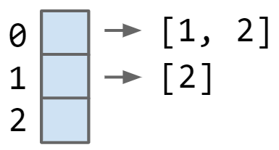
Our Graph API and Implementation
Our choice of how to implement the Graph API has profound implications on runtime.
Example: Saw that print on Adjacency Lists was O(V + E).

Slide 68
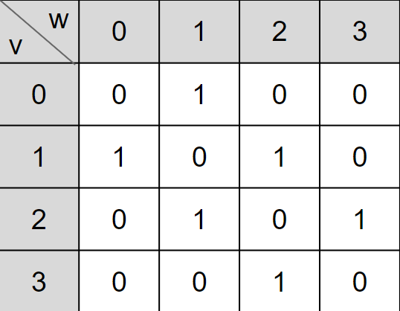
Our Graph API and Implementation
Our choice of how to implement the Graph API has profound implications on runtime.
What happens to print runtime if we use an adjacency matrix?

Slide 69
Graph Representations
Graph Representation 1: Adjacency Matrix.
G.adj(2) would return an iterator where we can call next() up to two times
next() returns 1
next() returns 3
Total runtime to iterate over all neighbors of v is Θ(V).
Underlying code has to iterate through entire array to handle next() and hasNext() calls.
w
 | 0 | 1 | 2 | 3
0 | 0 | 1 | 0 | 0
1 | 1 | 0 | 1 | 0
2 | 0 | 1 | 0 | 1
3 | 0 | 0 | 1 | 0
v
1
G.adj(2) returns an iterator that will ultimately provide 1, then 3.
0
2
3

Slide 70
Graph Printing Runtime: http://yellkey.com/pretty
What is the order of growth of the running time of the print client from before if the graph uses an adjacency-matrix representation, where V is the number of vertices, and E is the total number of edges?
Θ(V)
Θ(V + E)
Θ(V²)
Θ(V*E)
Runtime to iterate over v’s neighbors?
How many vertices do we consider?
for (int v = 0; v < G.V(); v += 1) {
for (int w : G.adj(v)) {
System.out.println(v + “-” + w);
}
}
 | 0 | 1 | 2 | 3
0 | 0 | 1 | 0 | 0
1 | 1 | 0 | 1 | 0
2 | 0 | 1 | 0 | 1
3 | 0 | 0 | 1 | 0
1
0
2
3
Notes:
https://docs.google.com/forms/d/e/1FAIpQLSfZareTvrnjPEdL7uBMsZCSLqg_M4KCX5xwJBrGpvbNy0i3uQ/viewform

Slide 71
Graph Printing Runtime
What is the order of growth of the running time of the print client from before if the graph uses an adjacency-matrix representation, where V is the number of vertices, and E is the total number of edges?
Θ(V)
Θ(V + E)
Θ(V²)
Θ(V*E)
Runtime to iterate over v’s neighbors?
Θ(V).
How many vertices do we consider?
V times.
for (int v = 0; v < G.V(); v += 1) {
for (int w : G.adj(v)) {
System.out.println(v + “-” + w);
}
}
 | 0 | 1 | 2 | 3
0 | 0 | 1 | 0 | 0
1 | 1 | 0 | 1 | 0
2 | 0 | 1 | 0 | 1
3 | 0 | 0 | 1 | 0
1
0
2
3

Slide 72
Runtime for DepthFirstPaths
Give a tight O bound for the runtime for the DepthFirstPaths constructor.
public class DepthFirstPaths {
private boolean[] marked;
private int[] edgeTo;
private int s;
public DepthFirstPaths(Graph G, int s) {
...
dfs(G, s);
}
private void dfs(Graph G, int v) {
marked[v] = true;
for (int w : G.adj(v)) {
if (!marked[w]) {
edgeTo[w] = v;
dfs(G, w);
}
}
} ...
}
This is a lot to digest!
If you are feeling lost on this problem, don’t feel bad.
But do work on trying to understand the ideas here!
Assume graph uses adjacency matrix!

Slide 73
Runtime for DepthFirstPaths
Give a tight O bound for the runtime for the DepthFirstPaths constructor.
public class DepthFirstPaths {
private boolean[] marked;
private int[] edgeTo;
private int s;
public DepthFirstPaths(Graph G, int s) {
...
dfs(G, s);
}
private void dfs(Graph G, int v) {
marked[v] = true;
for (int w : G.adj(v)) {
if (!marked[w]) {
edgeTo[w] = v;
dfs(G, w);
}
}
} ...
}
O(V²)
In the worst case, we iterate over the neighbors of all vertices.
We create ≤ V iterators.
Each one takes a total of Θ(V) time to iterate over.
Essentially, iterating over the entire adjacency matrix takes O(V²) time.
Assume graph uses adjacency matrix!

Slide 74
Graph Problems for Adjacency Matrix Based Graphs
Problem | Problem Description | Solution | Efficiency (adj. matrix)
s-t paths | Find a path from s to every reachable vertex. | DepthFirstPaths.java Demo | O(V²) time Θ(V) space
s-t shortest paths | Find a shortest path from s to every reachable vertex. | BreadthFirstPaths.java Demo | O(V²) time Θ(V) space
If we use an adjacency matrix, BFS and DFS become O(V²).
For sparse graphs (number of edges << V for most vertices), this is terrible runtime.
Thus, we’ll always use adjacency-list unless otherwise stated.

Slide 75
Project 2B Note
The All Paths Problem
Princeton Graphs API
DepthFirstPaths Implementation
The Adjacency List
DepthFirstPaths Runtime
The All Shortest Paths Problem
BreadthFirstPaths
BreadthFirstPaths Implementation
Graph Implementations and Runtime
Project 2B Note
Lecture 23, CS61B, Spring 2024

Slide 76
Project Note
On project 2B, you cannot import the Princeton Graphs library.
We want you to design your own graph API that has just the operations you need of the project.
Note: You may not need a separate Graph class. Whether you have one is up to you.

Slide 77
Summary
Graph API: We used the Princeton algorithms book API today.
This is just one possible graph API. We’ll see other graph APIs in this class.
You’ll decide on your own graph API in project 2B.
Choice of API determines how client needs to think in order to write code.
e.g. Getting the degree of a vertex requires many lines of code with this choice of API.
Choice may also affect runtime and memory of client programs.
public class Graph {
public Graph(int V): Create empty graph with v vertices
public void addEdge(int v, int w): add an edge v-w
Iterable<Integer> adj(int v): vertices adjacent to v
int V(): number of vertices
int E(): number of edges ...

Slide 78
Summary
Graph Implementations: Saw three ways to implement our graph API.
Adjacency matrix.
List of edges.
Adjacency list (most common in practice).
BFS: Uses a queue instead of recursion to track what work needs to be done.
Choice of implementation has big impact on runtime and memory usage!
DFS and BFS runtime with adjacency list: O(V + E)
DFS and BFS runtime with adjacency matrix: O(V²)

